Slide 1





National
Fire
Information
Database
September 17, 2017

Slide 2

Agenda
Welcome
Goals and objectives
Key Messages NFID
Key Messages Stats Can Report
Sustainability
Next steps

Slide 3

Background
$0.8 million Pilot Project funded by Defense Research Development Canada (DRDC) over a three year period in Partnership with Public Safety Canada
The Core Goals
  Improve evidence-based decision-making
  Enhance fire operations
  Enable effective policy creation
  Increase the quality of research & trend analysis related to fire incidents in all parts of Canada

Slide 4
Where We Are Today
A database exists! 10 years of 10, 7 jurisdictions, 72% of the population represented
An first study by Statistics Canada give some initial interesting information (more to come)
Ten more studies expected in December
Looking at how we can make the database accessible to researchers
Looking at how (if) we can build and better the database (today)

Slide 5
Three Basic Phases
Planning & Alignment
Technology Implementation & Analysis
Knowledge Distribution & Research Development
Literature Review
Implement Taxonomy
Community Outreach
Aggregate Data
Connect to other data
Publish National Analysis
Develop Questions
Initiate & Manage Research Projects
Make data available
Sustainability
Outreach

Slide 6
Goals & Objectives
To ensure that all CAFC Board, NAC and CCFMFC members are aware of the status of the NFID
To discuss the Statistics Canada report and release
To explore shared views on the NFID in terms of needs, wants, opportunities, and growth
To develop the basis for a sustainability plan for the National Fire Incidence Database

Slide 7
Q&A NFID #1-3
1. What is the National Fire Incidence Database (NFID)? The NFID is a demonstration database that describes three types of fires: structural, vehicular and outdoor fires, in Canada from 2005 to 2014.
2. Who built the NFID? A team effort between the CAFC, the CCFM&FM and our funders Canadian Safety and Security Centre, DRDC and Public Safety Canada.
3. Why is the NFID important? Tells us about fire incidents (location time date), fire protection features, circumstances contributing to outbreak, factors relating to origin and spread; fire loss details; discovery of fire and actions taken fire casualties; other socioeconomic data; it consolidates data from across Canada;

Slide 8
Q&A NFID #5
4. Why is the NFID important?
The NFID tells us about fire incidents (location time date), fire protection features, circumstances contributing to outbreak, factors relating to origin and spread; fire loss details; discovery of fire and actions taken fire casualties; other socioeconomic data;
It consolidates data from across Canada eventually allowing for the identification of leading practice and evidence informed policy
It is a starting point for continually refining information that may be provided in the future and mining information from the past.

Slide 9
Q&A NFID #6
5. What types of studies are being done with the NFID data:
Currently, 10 studies are being conducted using NFID data by researcher teams across the country. These will be completed in December 2017.
Statistics Canada has also prepared the first study on a select set of data-points. This study will be released at Fire Rescue Canada.
You can conduct many studies with the database’s 73 elements. Please contact the CAFC for more information.

Slide 10
Q&A NFID #7
6. What are the limitations of the NFID?
  The NFID is a starting point.
  There are some reliability issues that will be resolved with time.
  You must use the data with caution particularly when drawing conclusions that have policy implications.
  The specific limitations include:
    Coverage:
    Underreporting:
    First Nations:
    High level of unknowns:

Slide 11
Q&A NFID #8
What are the next steps? [TBC]
Refine, mine, analyze, grow build and improve the NFID
This requires both analytical and financial resources.
The CAFC and the Fire Marshalls and Fire Commissioners are meeting on September 17 to discuss next steps
READ the next steps report here
How can I access the National Fire Incidence database?
The goal of the CAFC, the CCFM&FC and our partners is to eventually make the NFID freely accessible to all researchers. Please check nfidcanada.ca for udpates

Slide 12
Key Messages Stats CaN ReporT #1
Pleased to see 1st report of NFID!
Shows what can be done with the data and what limitations exist. Good start but must be used with caution. For example:
  The report also focusses on incidences, injuries and deaths. It is silent on impacts.
  There is missing data for many elements so we may not see full picture.

Slide 13
Key Messages Stats CaN ReporT #1
Pleased to see 1st report of NFID!
Shows what can be done with the data and what limitations exist. Good start but must be used with caution. For example:
  The report also focusses on incidences, injuries and deaths. It is silent on impacts.
  There is missing data for many elements so we may not see full picture.

Slide 14
Key Messages Stats CaN ReporT #1
Pleased to see 1st report of NFID!
Shows what can be done with the data and what limitations exist. Good start but must be used with caution. For example:
  The report also focusses on incidences, injuries and deaths. It is silent on impacts.
  There is missing data for many elements so we may not see full picture.

Slide 15
Key Messages Stats CaN ReporT #1
Pleased to see 1st report of NFID!
Shows what can be done with the data and what limitations exist. Good start but must be used with caution. For example:
  The report also focusses on incidences, injuries and deaths. It is silent on impacts.
  There is missing data for many elements so we may not see full picture.

Slide 16
Key Messages Stats CaN ReporT #2
The report also shows us that
  Among the fires in the database residential fires make up the highest number
  Of residential fires, cooking fires make up the highest number.
  Heating and smoking fires are going down
  Risk of death increases where no smoke alarm
  Risk of death to seniors is higher than for others

Slide 17
Key Messages Stats Can Report #3
The report serves as a reminder of the importance of working smoke alarms. Canadians are also urged to exercise caution in cooking activities.
The next phase we’d like to understand a total costs of fires per province or in percentages of total CDN domestic product and its impact on progress from a socio economic perspective.

Slide 18
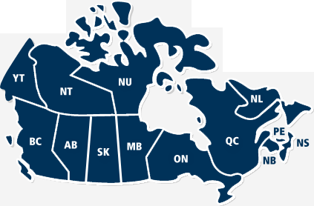
National Coverage of NFID
72% of Canadian Population
DND

Slide 19
Upcoming Research Projects…
 | UNIVERSITY | Applicant | Approved Submission
1 | Lakehead | Sinden | Firefighter burden of injury relative to specific fire response characteristics
2 | Murdoch | Clare | At Risk Populations
3 | UBC | Pike | Burden and Epidemiology of Residential Fire Injuries Among Children and Youth in Western Canada
4 | UBC | Hewage | Dynamic fire predictive model for residential buildings
5 | Calgary | Hassan | Wildland Fire-induced Risk Modelling Framework for the Greater Athabasca Oil Sand Region
6 | Regina | Jurdi-Hage | Incidence, Circumstances and Risk Factors of Residential Cooking Fires in Canada
7 | Wilfrid Laurier | Kelly | The Role of Insurance in Reducing the Frequency and Severity of Fire Losses
8 | York | Asgary | Fires and Disasters: Examining Fire Incidents during Major Disasters and Emergencies in Canada
9 | York | Solis | Developing a fire response simulation test bench based on NFID
10 | York | Yang | Using statistical and machine learning approaches to investigate the factors affecting fire incidents

Slide 20
OUTREACH

Slide 21
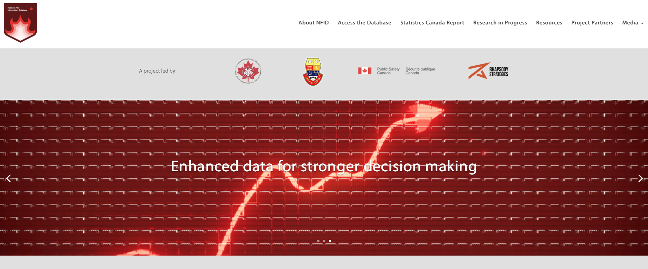
What’s Coming Next
Updated website, NFID breakfast, press release, access to database

Slide 22
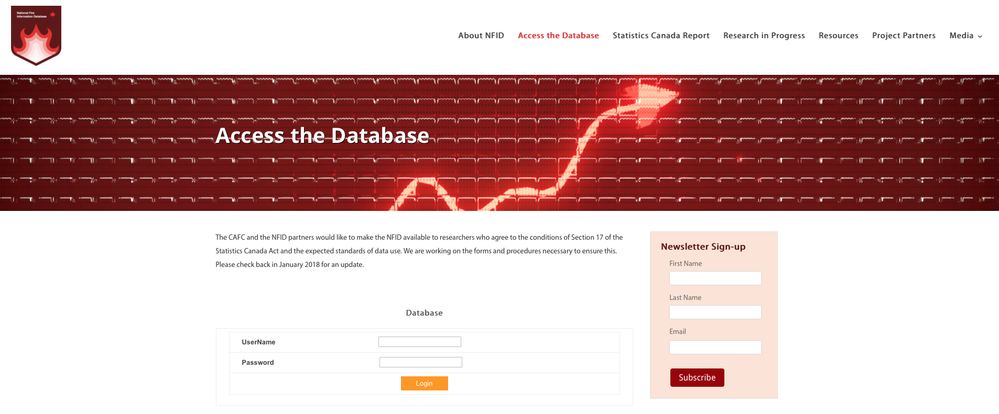
What’s Coming Next
Updated website, NFID breakfast, press release, access to database

Slide 23
Why make database available?
Make the data available
Know who is doing what?
Spread knowledge about who did what with the data
Show effectiveness
Engage more people
Show demand
Build case for sponsorship/funding
increase success rates in grant applications
For funded studies ask for a small % of the funding to go into the sustainability fund.

Slide 24
SUSTAINABILITY

Slide 25
what Does statistics Canada Say about next steps?
Improve Participation/coverage rates
Increase frequency of data collection
Ensure highest level of data quality
Improve data collection methodology
Improve capacity for future record linkage
Communications and networking

Slide 26
What does Sustainability
mean to you?

Slide 27
How important is?
Sustainability of NFID?
 | Very important
 | Important
 | Not that important

Slide 28
How IMPORTANT IS IT?
Improve capacity for future record linkage
 | Very important
 | Important
 | Not that important

Slide 29
How IMPORTANT IS IT?
Increase frequency of data collection
 | Very important
 | Important
 | Not that important

Slide 30
How much do you Agree?
Improving Participation/coverage rates
 | Very important
 | Important
 | Not that important

Slide 31
HoW IMPORTANT IS IT?
increase coverage of NFID (iE add More Provinces/Territories)?
 | Very important
 | Important
 | Not that important

Slide 32
How important IS IT
To update the NFID (i.e. add data beyond 2014)
 | Very important
 | Important
 | Not that important

Slide 33
How important IS IT TO MINE THE NFID? (IE DO MORE STUDIES)
 | Very important
 | Important
 | Not that important

Slide 34
How important IS IT TO simplify the data entry form?
 | Very important
 | Important
 | Not that important

Slide 35
How feasible is a standardized data collection form?
 | Very important
 | Important
 | Not that important

Slide 36
What strategies can be used to resource sustainability?

Slide 37
THANK YOU

